Slide 1
SAMPLE ecommerce dashboard analysis
Presented by-Amitha Deepak , PMP

Slide 2
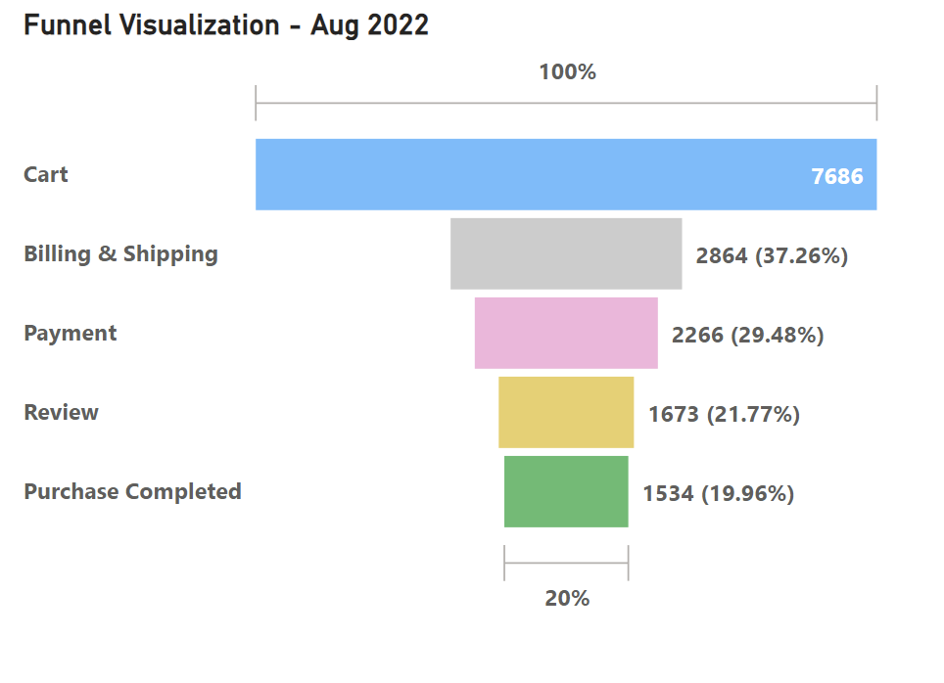
Funnel Level behavior
Funnel level behavior can be improved by the following steps:
Get in front of the right audience .
Focus on the right channel.
Optimize website content around specific terms.
Paying to place digital ads on websites, social media, email or video platforms etc.
Forming promotional partnership with other brand influencers.
Consistency in online presence is a must.
Note : In order to understand on how the marketing funnel is performing we need to focus on the bounce rate on landing page and exit % in exit page.
Rise Awareness
Consideration
Actively browsing website
Making a good impression is key.
Conversion
User friendly experience
Loyalty ☺

Slide 3
Awareness , trust & loyalty…..
Awareness
Metric related to brand awarness
Consideration
Metric related to engagement
Company to needs to make effort to learn about the audience.
Research needs to be made to find the new customer online.
Tailor content for the social media account to reach the right audience.
Clear and meaningful goals in place can help to know how to measure success.
Learning about customer needs and paint points of specific and potential customers need to solve.
By understanding the pain points, we can understand how and why customers are interacting your business.
In order to get better result from the marketing funnel , we need to analyze below dashboards:
Landing Page Review
Exit Page Review
Analyze Returning Users
Conversion
Track referal
Loyalty ☺
Customer Testimonail
ReviewNet promotor score

Slide 4
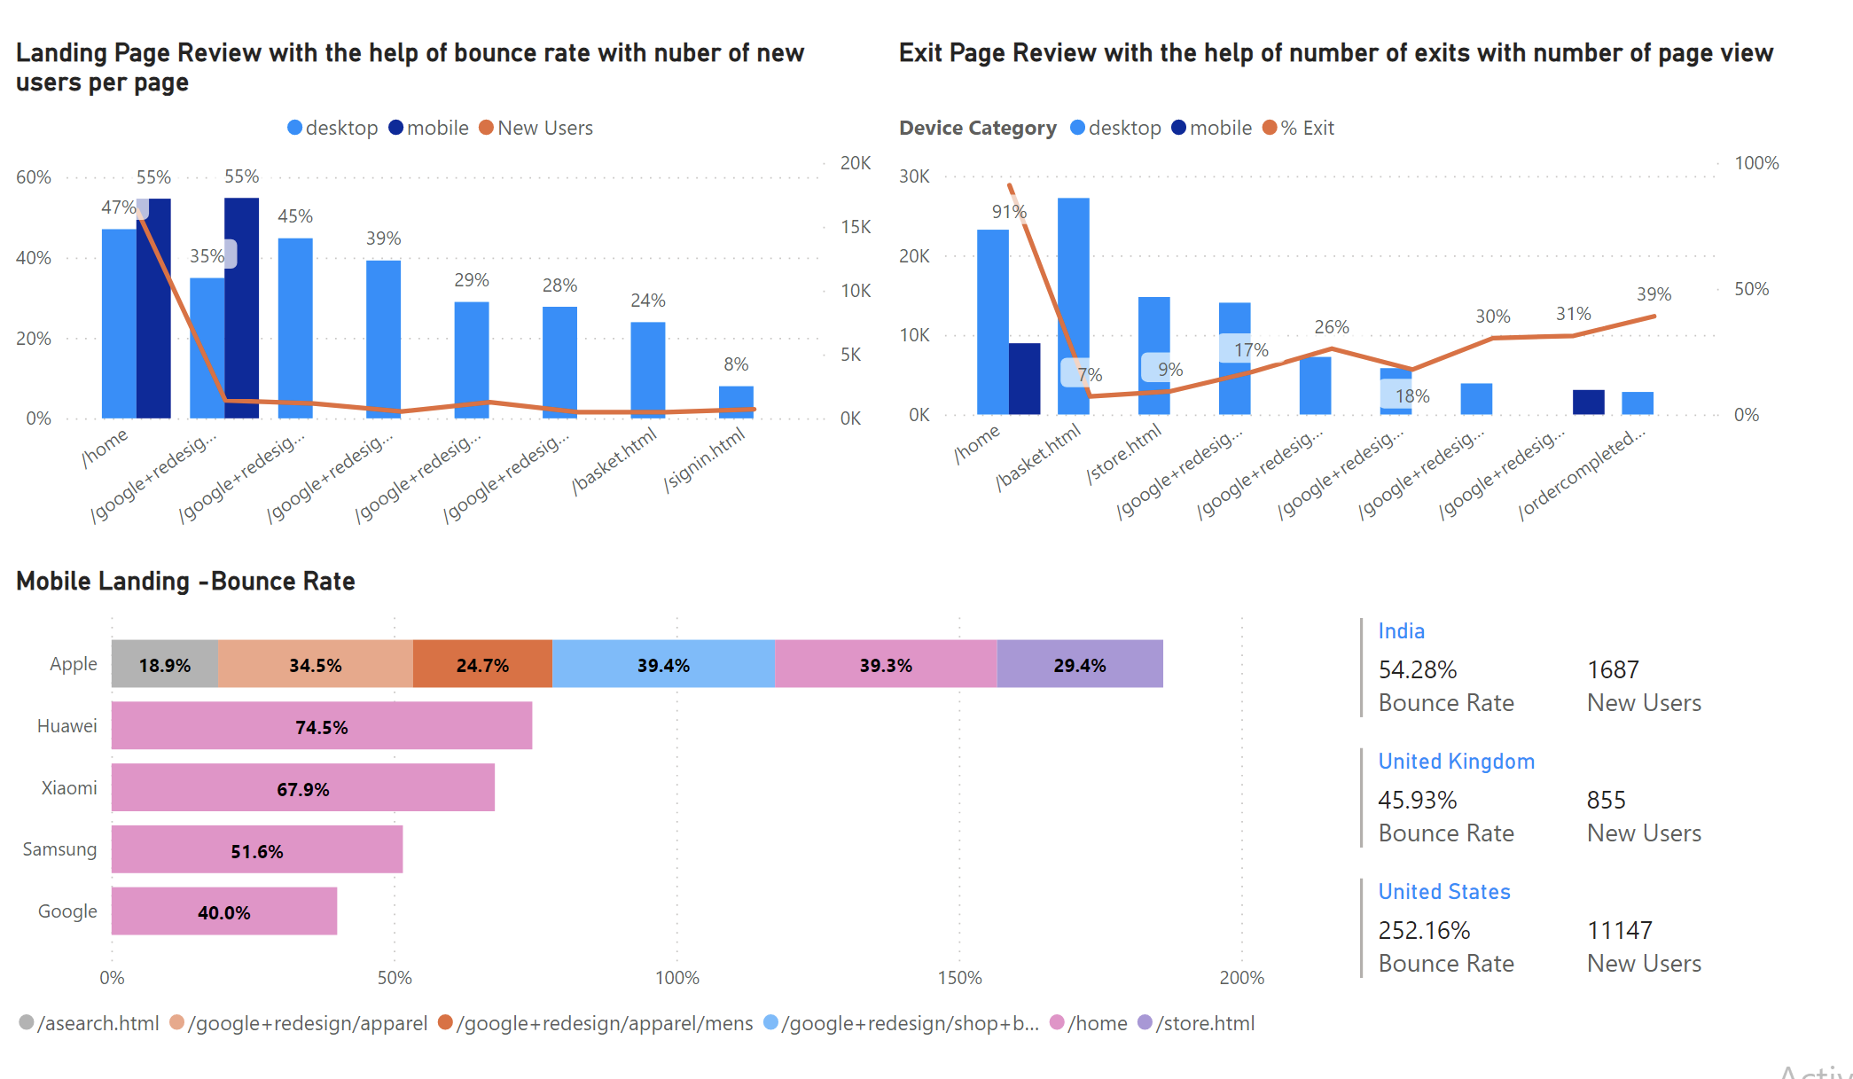
Landing & exit page – metric analysis

Slide 5
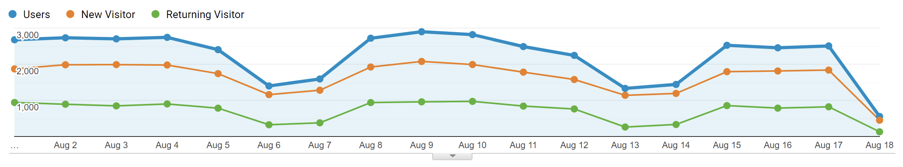
New & returning user behavior
Digital marketing helps companies by guiding all of the company customer interaction.
By tracking the number of returning users we can understand brand reach.
It helps the company to think strategically through digital channels before ,during and after purchases.
We can see that compared to the new users the returning user number is declining in order to understand in depth we need to understand whether the site is engaging or user friendly in all types of devices.

Slide 6
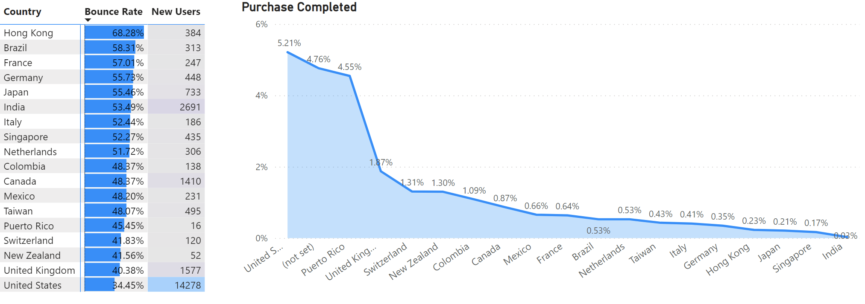
Understanding high bounce rate and low conversion rate-Location
Need to analyze why the bounce rate is high even with high new user
We need to focus more on the countries where the new users are high and bounce rate is low we need to make more research and customize the website content for other locations where the bounce rate is high by studying the successful locations and implementing some similar techniques

Slide 7
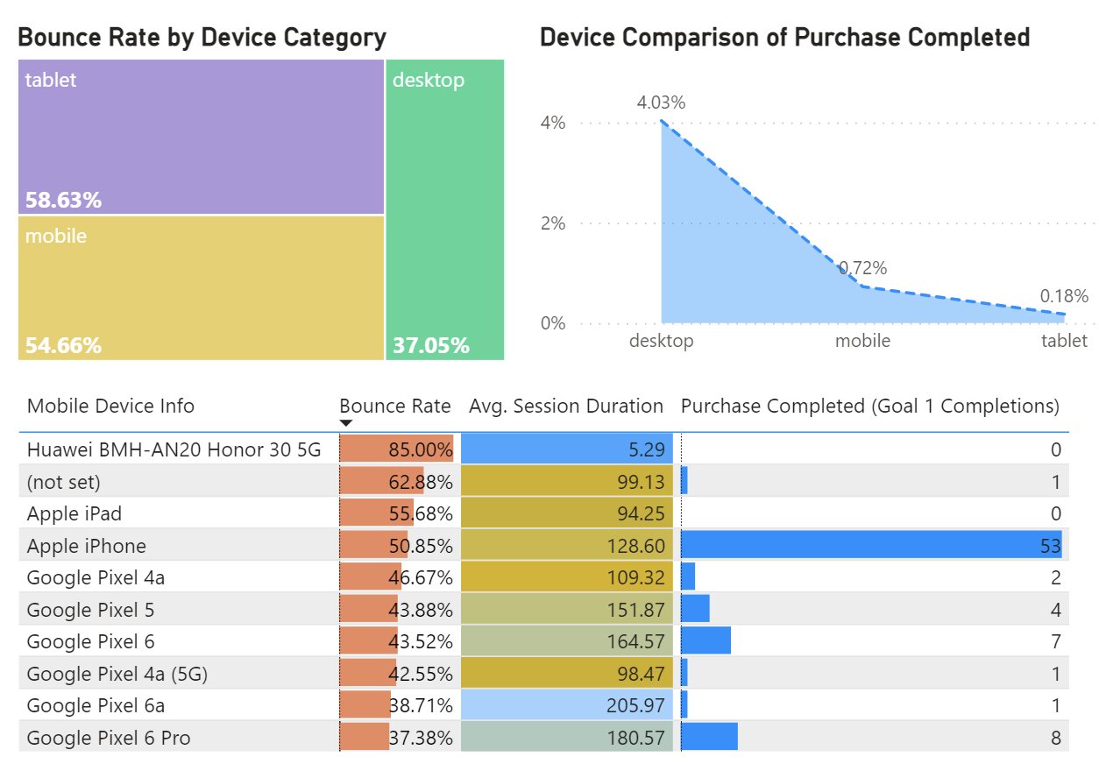
Understanding high bounce rate and low conversion rate-Device
Bounce rate is very high in tablet and mobile action needs to be taken especially mobile by customizing the website and screen setup .
Need to work on the high bounce rate in Huawei BMH device .
Under mobile device there is (not set) column where the bounce rate is high, we need to figure out the devices allocated in not set category.
Apple iPhone is doing exceptionally high with 50% bounce rate need to understand the success reason.
Google Pixel has high average session rate but very less purchase completed need to do research on why customers are opting out before the final purchase.

Slide 8
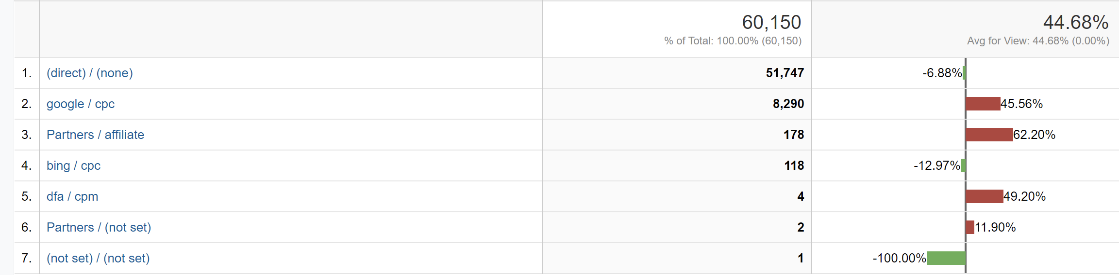

Understanding high bounce rate and low conversion rate-source/medium
A good indicator of traffic quality can be bounce rate . We need to investigate Partner /affiliate and Google/cpc traffic is bouncing at much higher rate .
Investigate why users are not landing on the useful page.
Bing/cpc activity are generating business .
Need to understand on the not set column and rectify it.

Slide 9
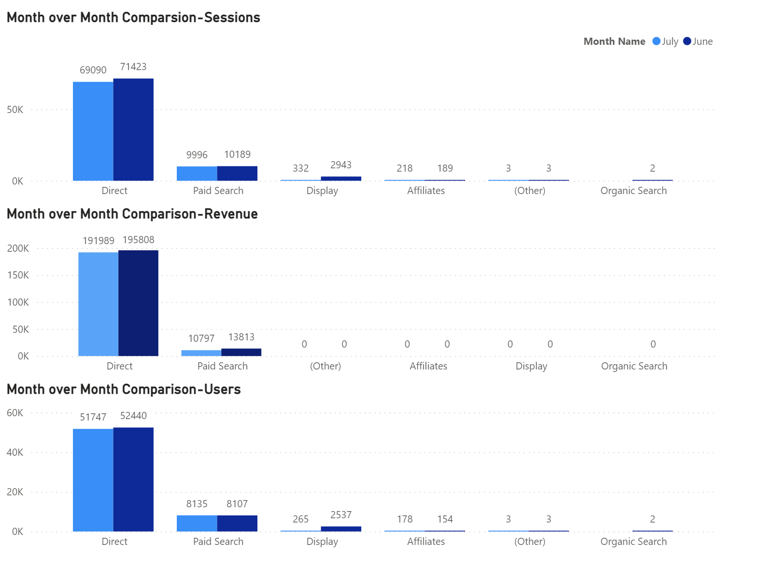
Month over month comparison

Slide 10
THANK YOU

